Slide 1
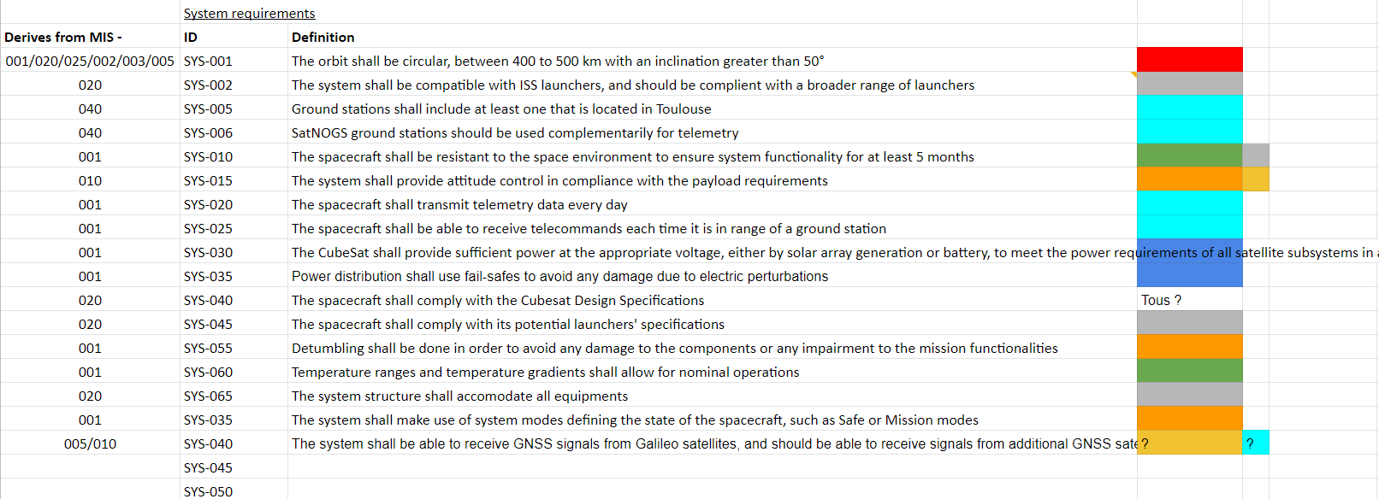
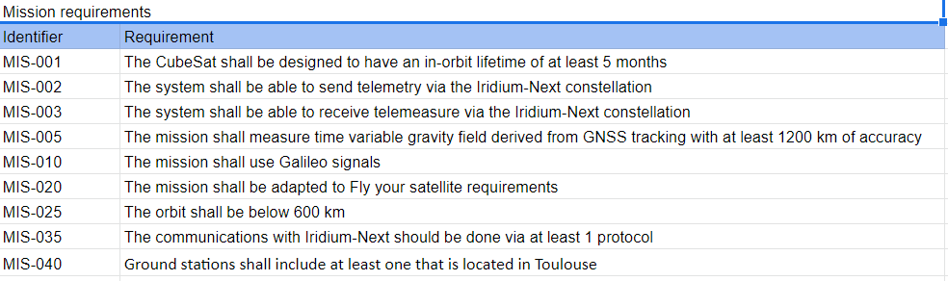
Mission Requirements
Javier Navarro - INSA
Pierre-Yves Schini - ISAE

Slide 2
Mission Requirements
MIS-001 | The CubeSat shall be designed to have an in-orbit lifetime of at least 5 months
MIS-002 | The system shall be able to send telemetry via the Iridium-Next constellation
MIS-003 | The system shall be able to receive telemeasures via the Iridium-Next constellation
MIS-005 | The mission shall measure time variable gravity field derived from GNSS tracking with at least 1200 km of accuracy
MIS-020 | The mission shall be adapted to Fly your satellite requirements
MIS-025 | The orbit shall be below 600 km
MIS-040 | Ground stations shall include at least one that is located in Toulouse
Mission Requirements

